Slide 1
Millie Fellows
FBDO, Secretary for Oxfordshire LOC and Non-Executive Clinical Director for LOCSU
Notes:
Welcome and thank you for having me here this evening, my name is Millie Fellows, I have been a Dispensing Optician for over 25 years. Spending most of my career in high street leadership roles. Early 2021 I joined my LOC as an admin support and was then elected as Secretary at their AGM in June. Since then, I have been fortunate to have been appointed to the board of LOCSU and the GOC fitness to practice panel.
My role on the LOCSU board, along with my 3 colleagues is to represent all LOC’s in England. Bringing the experience and knowledge of LOCs to LOCSU so that they can help support LOCs to deliver for their practitioners and ultimately patients.
I am here to talk to you about the sustainability journey we have made as a committee and how my role as an LOC representative on the board is helping to support the actions and tackle the challenges.

Slide 2
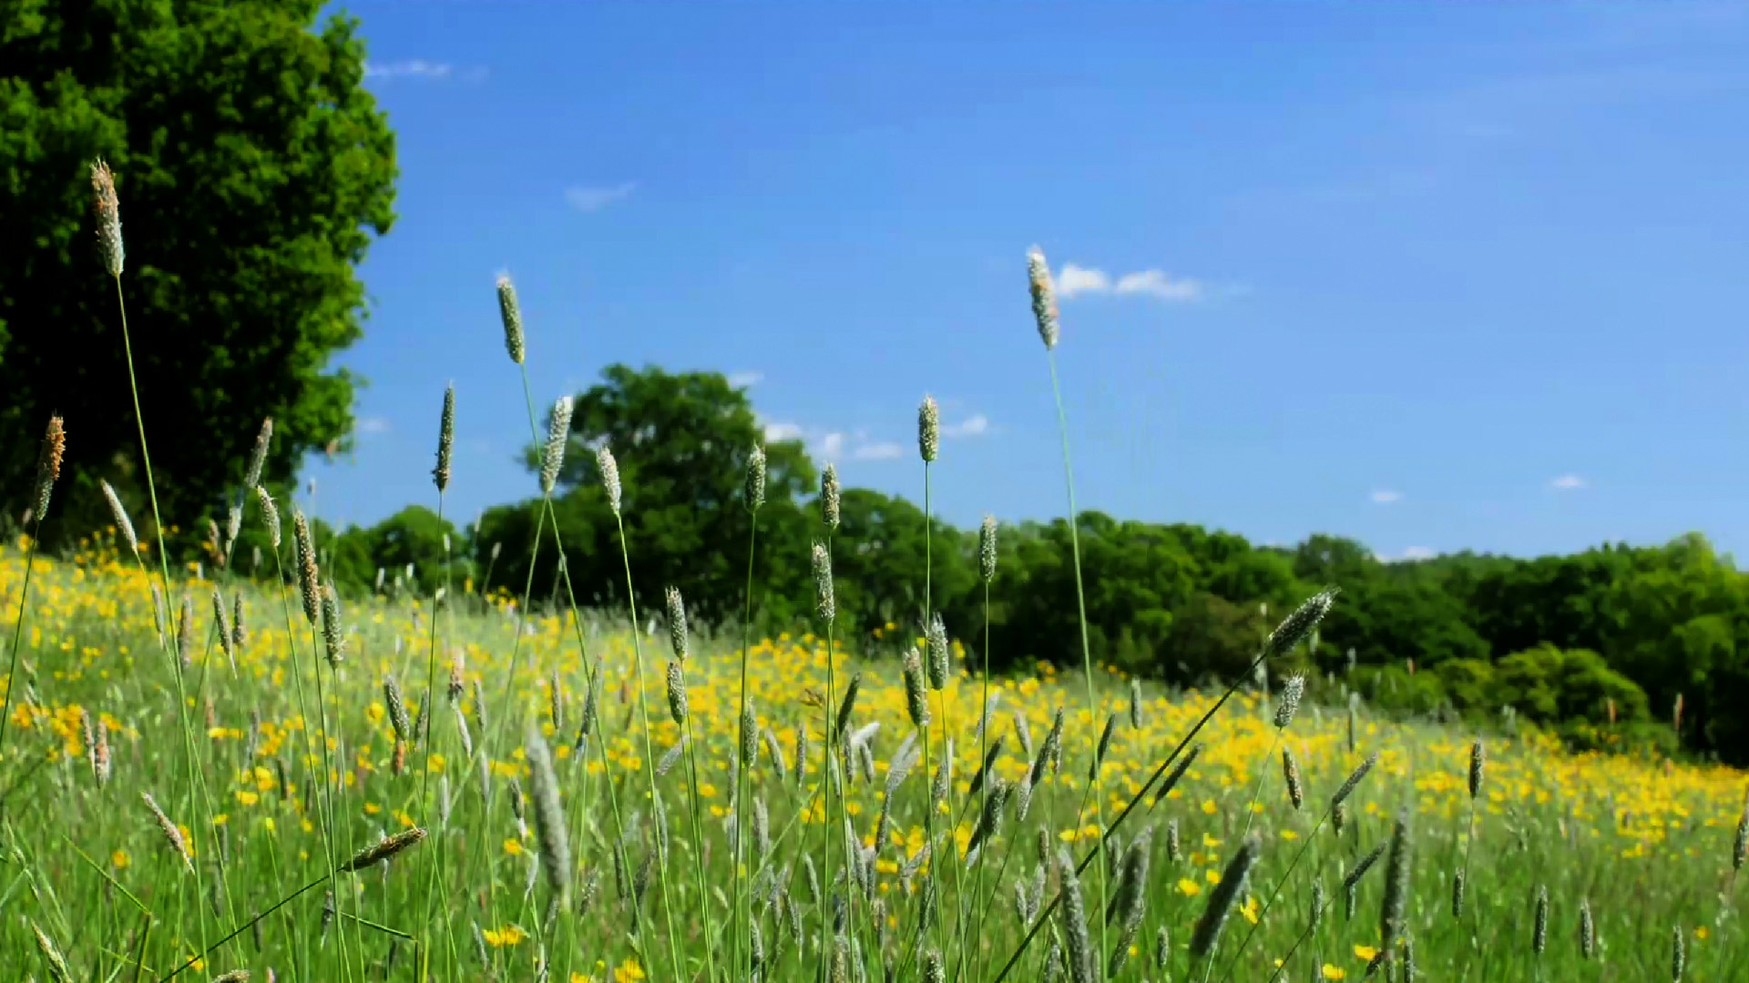
Sustainability
for LOCs
Notes:
I am not here as an expert but as someone with a passion for Sustainability. I am not here to give you all the answers, but I am here to inspire you.

Slide 3


What have we done so far?
Committee leadership
Sustainability Lead
Sustainability self-assessment tool
Sustainability sub committee
Notes:
So what have we done so far?
Oxfordshire has evolved over the last few years, with new branding, a strategic focus and a passion for Sustainability.
Committee Leadership the key to the success of a committee focussed on sustainability, this will not happen without the united vision from the full committee.
Sustainability Lead: this was borne at our second in person strategy day, an event we hold bi-annually. Our Vice Chair Ruth, who a lot of you may know, wanted to relinquish her officer role but remained fully engaged to the committee. As her other career is as a Senior Advisor for Natural England, we felt what better than to become our Sustainability Lead.
What does this mean in reality? What did we do?
The first thing we did as a committee was to carry out the Sustainability self-assessment tool, which can be found on the ABDO SEE hub. This was a desktop exercise with input from all members. We were pretty much all virtual meetings and paperless post covid, but the exercise really honed our processes. We achieved a gold badge, which we now proudly have on our website, but now the aspiration is to keep it.
We are constantly looking at ways to improve and keep momentum, so next steps: we have recently set up a sustainability subcommittee, guided by our Sustainability lead Ruth. They are currently looking at the next phase, which is engaging practices, through a nominated champion with a monthly email of Ideas and changes made to share with others in practices.

Slide 4
Don’t let perfect be the enemy of good
Notes:
Peter Davey who opened the summit told me about this quote: It really resonated with me and I had a perfect example for it.
Recently a colleague of mine has embarked on the journey of opening a brand new practice, but they wanted to do it sustainably.
The reality is that to be a truly sustainable practice would be so expensive that opening would not be financially viable.
Don’t let being “perfect” be the reason to not try . Instead like my colleague, start where with the possible, such as large stocks of sustainable brands, remote edging, energy efficient lighting and even sustainable toilet rolls! By making the changes you can initially, with a commitment to keep moving forward with the plan and inspiring others to follow is better than not doing it all because you can’t reach perfection.

Slide 5
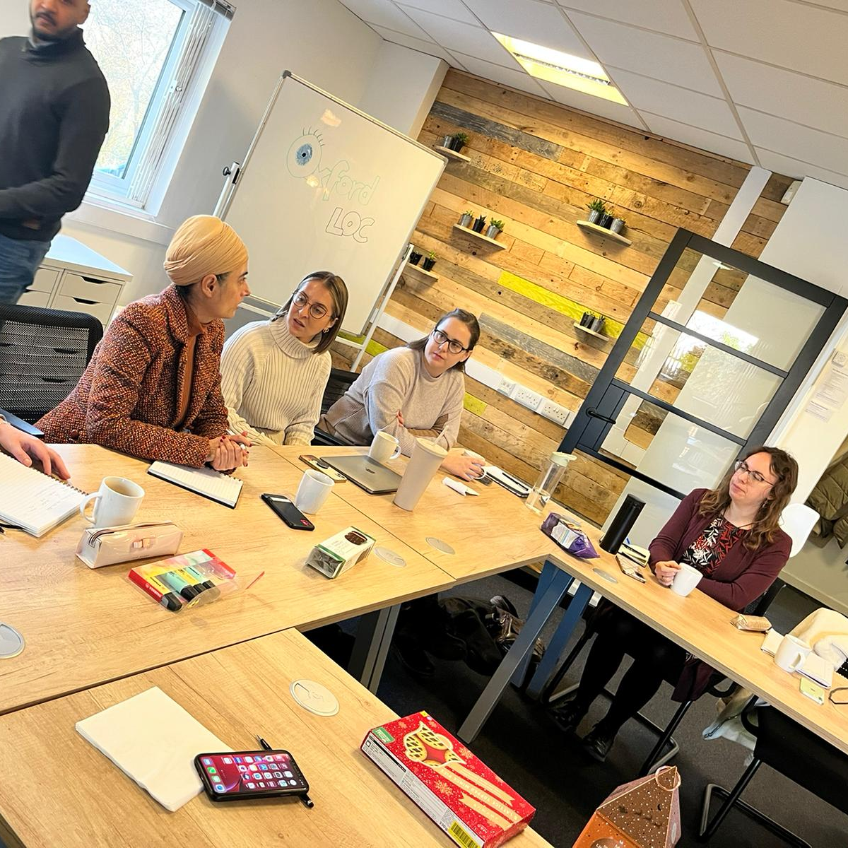
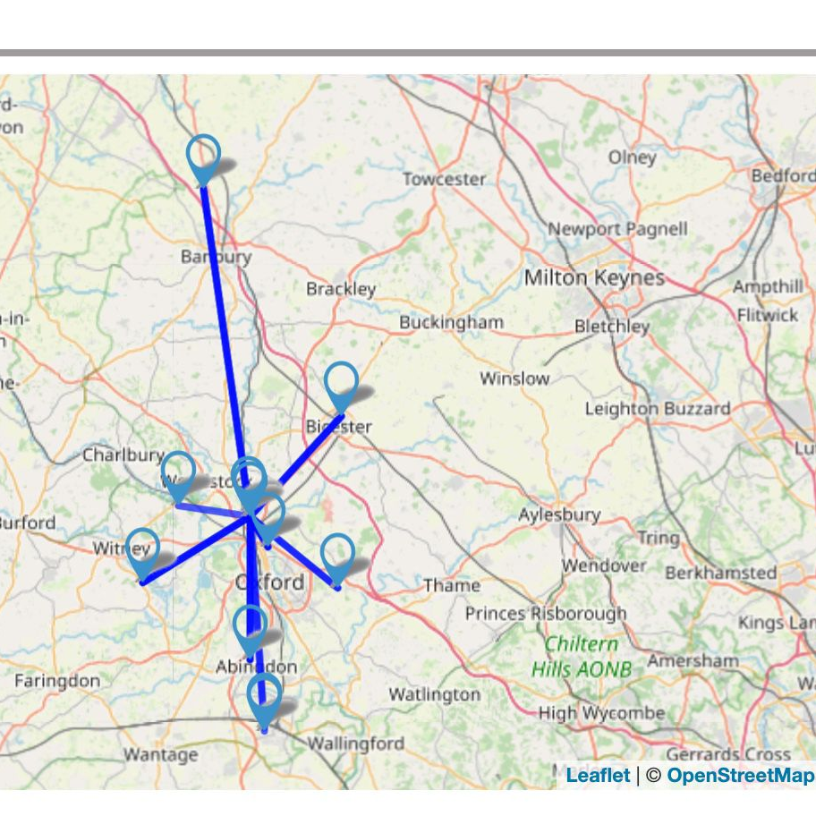
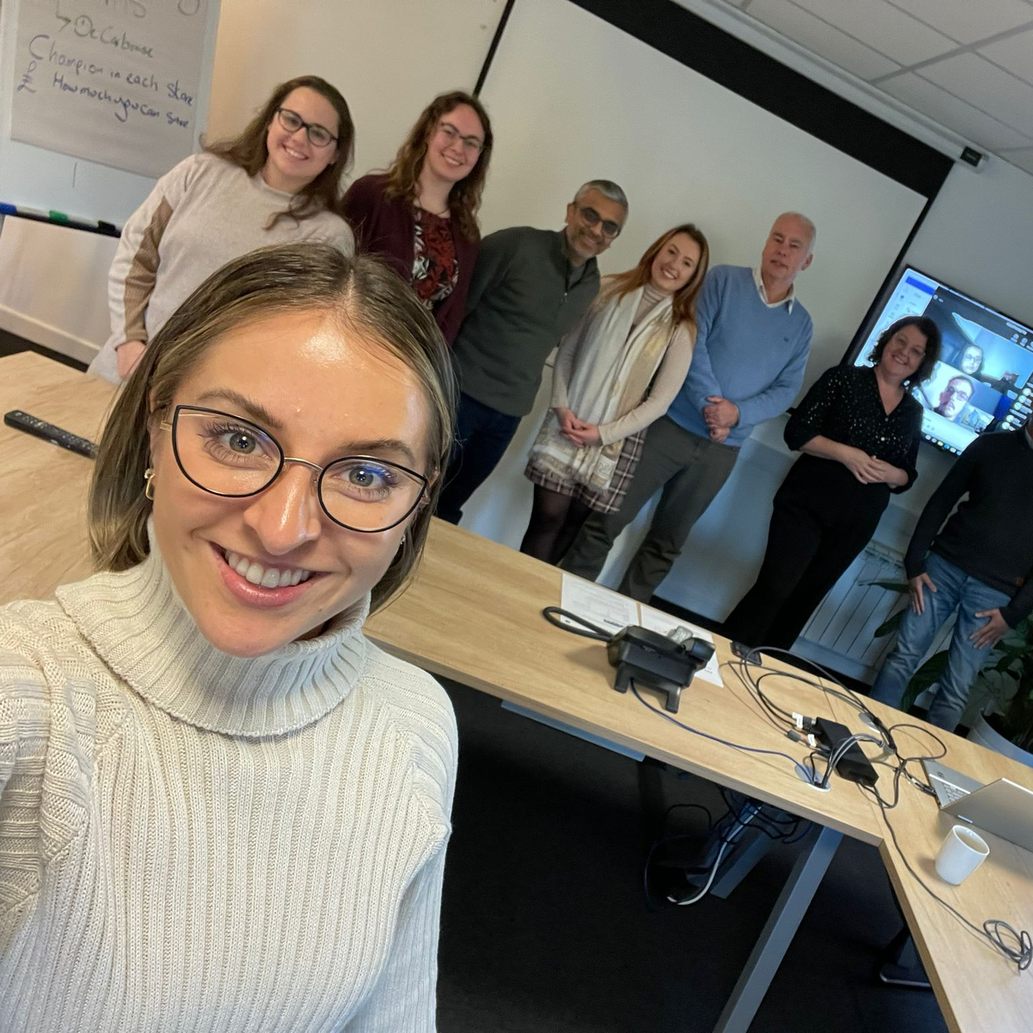
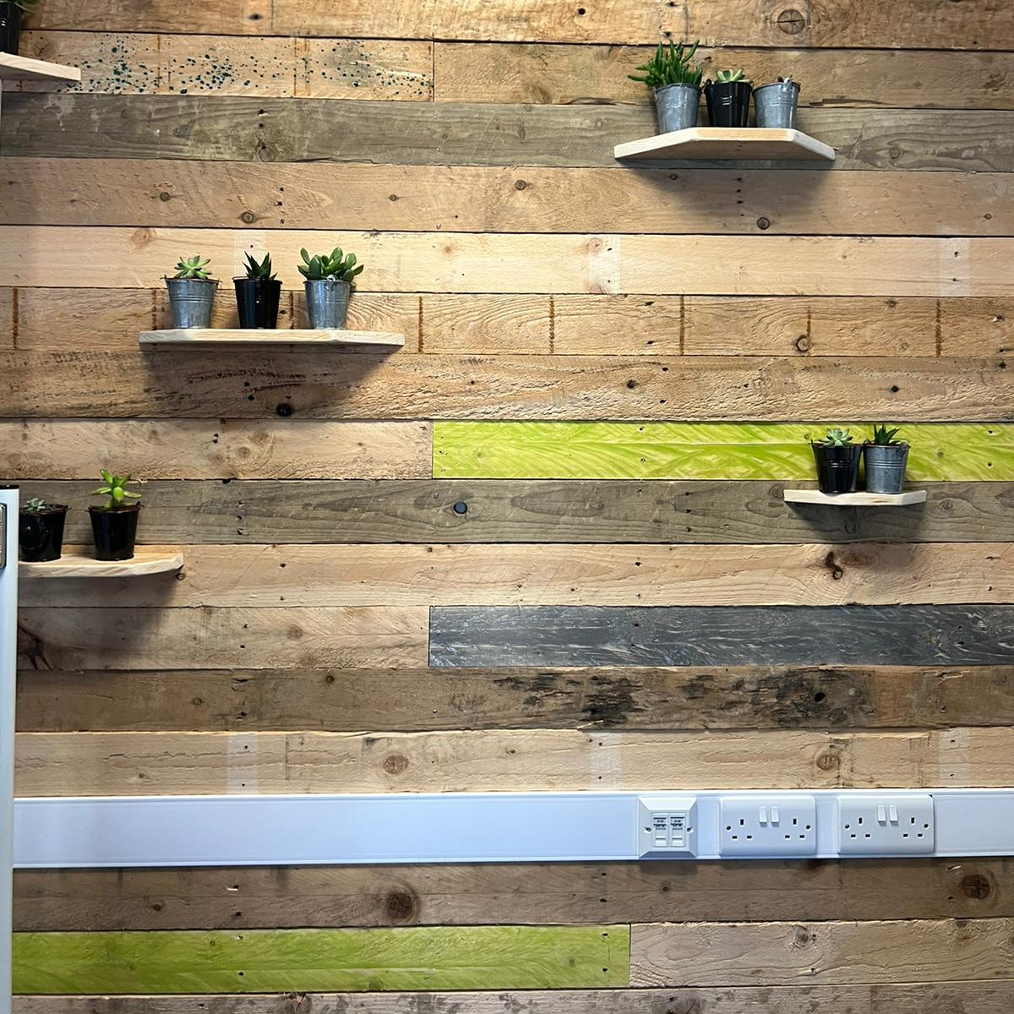
Green credentials: make good choices for LOC events
Do they have a green policy?
Look at the midpoint for county
Do they have the tech to allow dial in to reduce travel
Car share, expense policy to encourage
Notes:
Green credentials, what does that mean to us as an LOC.
We hold a face-to-face meeting with our committee twice a year.
We carried out an exercise using a web tool to find the midpoint from all the members home post codes. This then informed the central location which would be the best place to meet.
The next step was to find a venue with good green credentials, starting with a sustainability policy. Unfortunately, we couldn’t find anything midpoint so moved 12 miles to the Oxford Science park This boasted a thriving ecosystem, lift share scheme and extensive recycling facilities.
Although this was a great space it didn’t fulfil all our criteria, predominately allowing dial in options to maximise attendance as well as reducing travel for our colleagues who joined us out of area, such as LOCSU lead. So, we moved 10 miles from the mid point to Witney where we found a great space, with great sustainability policy . This included water saving plumbing, low energy lighting, reduction of single use plastics, hybrid working, reduced printing, cloud-based storage and EV car charging points. Additionally, they have big ambitions for 2023 including enlisting an organisation to look at offsetting their carbon emissions.
We also looked at our expense policy, changing it to include a higher rate per mile to reward the use of car share.

Slide 6
CPD Day

Slide 7
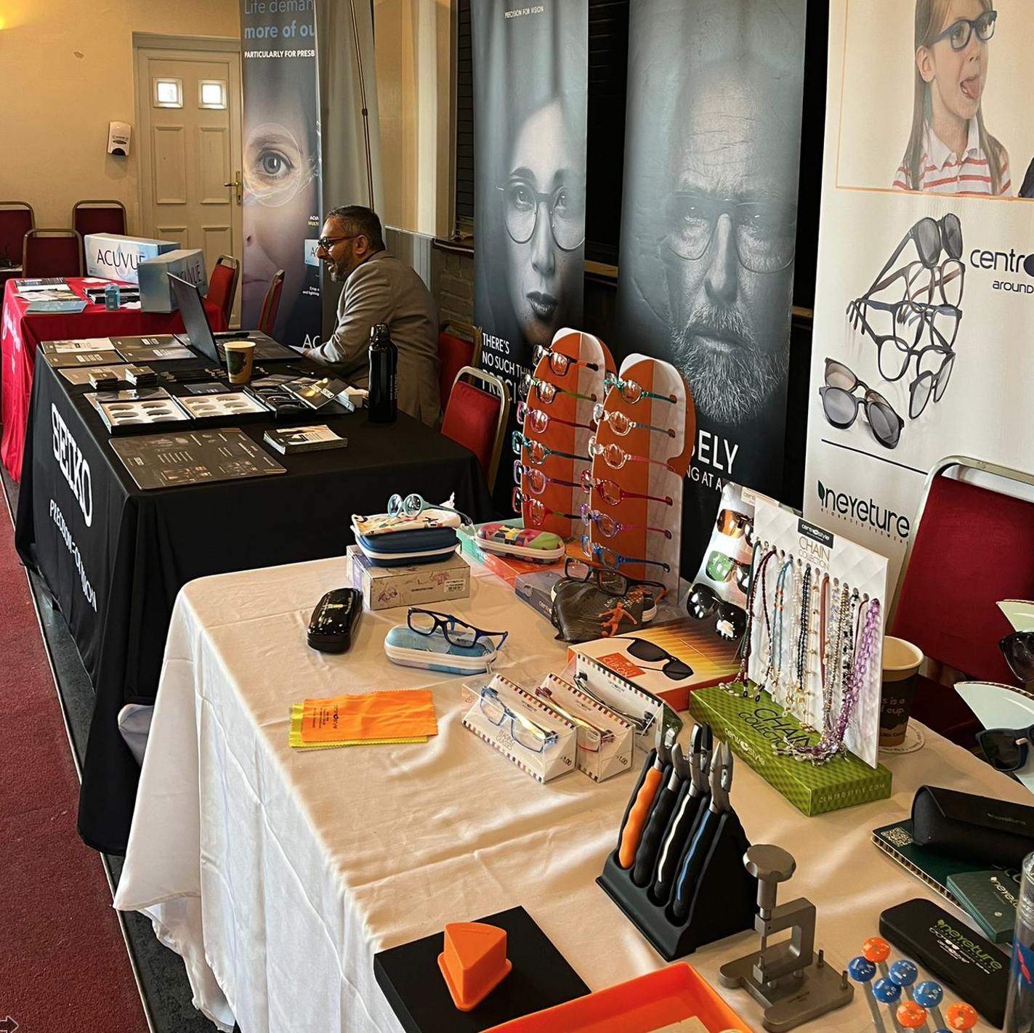
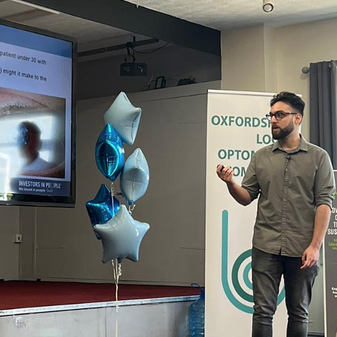
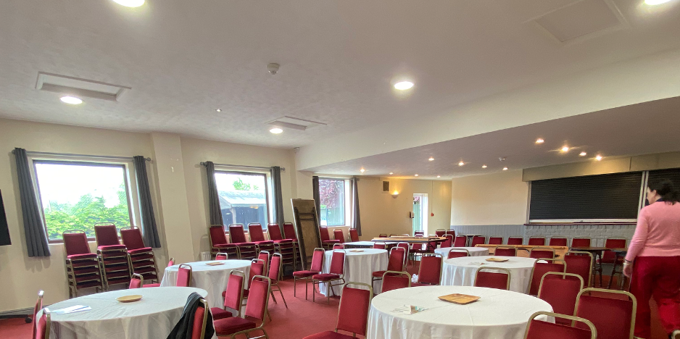
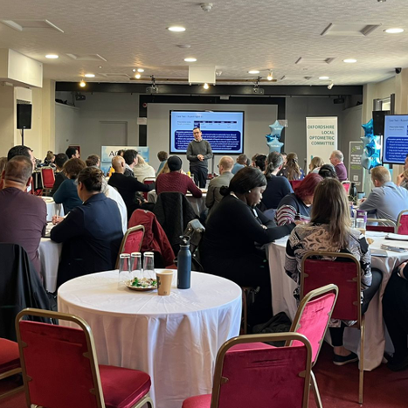
Sustainability front and centre
Hire water coolers
Delegates to bring own water bottles
Sponsors to use minimum hand outs, digital QR codes
Reuse Badges
Waste to taste caterers
Notes:
More and more sustainability became the lynch point for all activity, more so than ever at our CPD event.
This was held at the midpoint of the county, as the space we held our meetings was too small.
These are some of the things we did to keep the event sustainable.
Sourcing a Catering by a company “waste to taste”, no set meu to choose from just whatever they had needed to be used. Delivered by electric car and a strong social ethic, with meals to those in need in the county.
Water cooler hired, all unused bottles returned so no waste, no plastic cups all delegates asked to bring own water bottle or travel cup for the hot drinks. Did provide a limited numbers of biodegradable cups for those who forgot.
We asked all sponsors to provide QR codes rather than printed handouts and delegates was asked to bring phone or tablet to access, one copy per table provided and returned to supplier after use for peer discussions.
No leaflets, freebies and printed Items from sponsors for delegates
All delegate badge holders collected and kept for reuse at next event.
For our next event, we will set up recycle stations and a would like to source a sustainability expert to speak.

Slide 8
The importance of sharing

Slide 9
Sharing fuels innovation
LOCSU is well placed to collate and share ideas
Optical Bodies statement of intent
NHS greener net zero eyecare ‘think tank’, four key areas:
1. Keeping healthy
2. Right care right place & time
3. Low carb treatment settings
4. Clinical leadership & workforce
Notes:
LOCSU is well placed to collate and share ideas: I am championing this through my role on the board representing LOCs at LOSCSU.
Alongside the amazing work ABDO are doing with their SEE hub, your LOC represents all NHS contractors and performers so are well placed to support practices to share and collate ideas. My aspiration through working with LOCSU is to have all LOC’s optimise all sustainable options within their own committee’s. Then by leading by example this would encourage practices to deliver and share ideas. All contributing to the delivery of the statement of intent from our Optical bodies
Optical Bodies statement of intent: This can be found on the SEE Hub) sees many optical bodies Inc. AOP and BCLA pledging to help support and educate its members in this arena.
Representing LOCs I attended a National NHS greener Net zero eye care “think tank” with over 40 delegates from across the sector. It was an amazing experience, and I am looking forward to where this goes next. Ideas raised varied from “get kids in sun specs to reduce the number of cataracts in the future to online diagnostics and triage, to solar panels on hospitals”.
This will be explored further at our sustainability workshop at our National conference in November, so if you want to bring your own thoughts and ideas, this will be a great place to start.

Slide 10
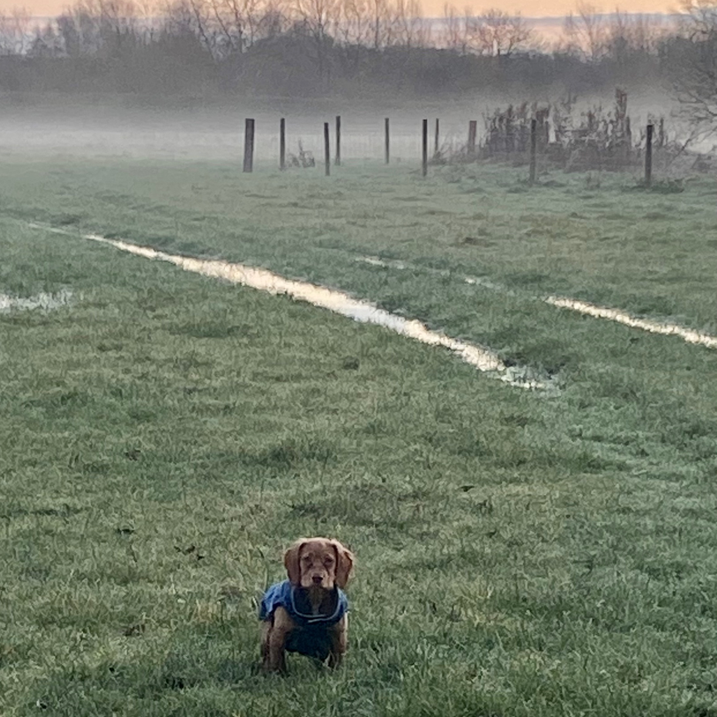
Turning problems into aspirations
Engaging members but required travel
Off setting carbon at min cost
‘Greenwashing’
Notes:
It is ok to not be able to achieve all the time. Realising issues and areas where we cannot achieve is just as important to the journey.
These are just a few of the challenges we have faced and not yet been able to overcome.
Engaging members but required travel: We knew the value would be seen in visiting practices and engaging with members, but this required travel. Whilst we mapped out the routes and car shared it was not ideal.
Off setting carbon at min cost: Then we have found it difficult to find cost effective ways to off set carbon, without the buy in of the community when spending contractors levy
“greenwashing”: The fear and reality of “green washing” and whilst we have the expertise of our Sustainability lead, we cannot be certain that we are always hitting the mark. This is where the support and resources of the NHS net zero and SEE HUB have become a much needed resource.
A frosty morning in a green space with my dog Basil, pictured here is a great reminder of what we are striving for.

Slide 11
Have you thought about sustainability?
Notes:
So it leaves me to close with “have you thought about Sustainability?”
“what can you do to challenge the status quo?
I would say speak up to your practice leaders, practice owners and suppliers.
Routinely use questions such as
“What about sustainability?” “Is that the best way to do this with sustainability in mind?”
Before you start to work either as a locum or a new hire or taking on a new supplier do you ask questions? For example “ Do you have a sustainability policy?”
If you are here as an LOC members add to the agenda, what are we doing about sustainability, if you are not on an LOC, ask them
“have you thought about sustainability” if the answer is no, or very little then as you are here you are obviously interested, so maybe think about joining your LOC and maybe you are the sustainability conscience they didn’t know they needed
Keep talking about It.
Keep it as a consideration when making key decisions.
Keep challenging!
Remember small changes are a start, simple as changing your copier and loo paper!
Thank you for your time, leaves me to say any questions?

